Slide 1
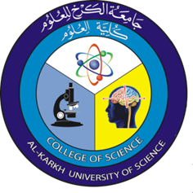
Optics Laboratory
2nd Grade - 1st Semester
2018/2019
Instructors
Assist. Prof. Dr. Sabah Ibrahim
Assist. Lect. Muhanned Jamal
Assist. Lect. Najwa Ibrahim

Slide 2
Experiment one: Reflection, Refraction, and Spherical Lenses
Objectives:
Understanding the laws of reflection and refraction.
Distinguish among converging and diverging spherical mirrors and lenses.
Determining the image characteristics for spherical mirrors and lenses.
Reflection:
When light strikes the surface of a material, some light is usually reflected. The reflection of light rays from a plane surface such as a glass plate or a plane mirror is described by the law of reflection: $θ_{i}=θ_{r}$
Refraction:
When light passes from one medium into an optically different medium at an angle other than normal to the surface, it is “bent,” or undergoes a change in direction.
Spherical Lenses:
Spherical lenses are used to cause light rays to converge and hence focus them (convex spherical lenses) and to cause light rays to diverge (concave spherical lenses). Many of us wear lenses in the form of eyeglasses.

